Slide 1
2014-15 SUNY Operating and Capital Budget Requests
Finance and Administration Committee
November 14, 2013
Fashion Institute of Technology

Slide 2
Economic Environment
State Budget¹
$93.8B
$98.2B
$101.5B
$84.4B
$87.2B
$88.8B
$90.7B
1 Excludes capital, federal, and off-budget items
2 Excludes State paid fringe benefits, debt service, and State funded grant programs (TAP)

Slide 3
Economic Environment
Debt Cap
$37.7B
$39.4B
$41.2B
$42.8B
Room Rem.
$ 4.1B
$ 3.6B
$ 3.6B
$ 2.4B

Slide 4
2014-15 SUNY Operating Budget Request
November 14, 2013

Slide 5
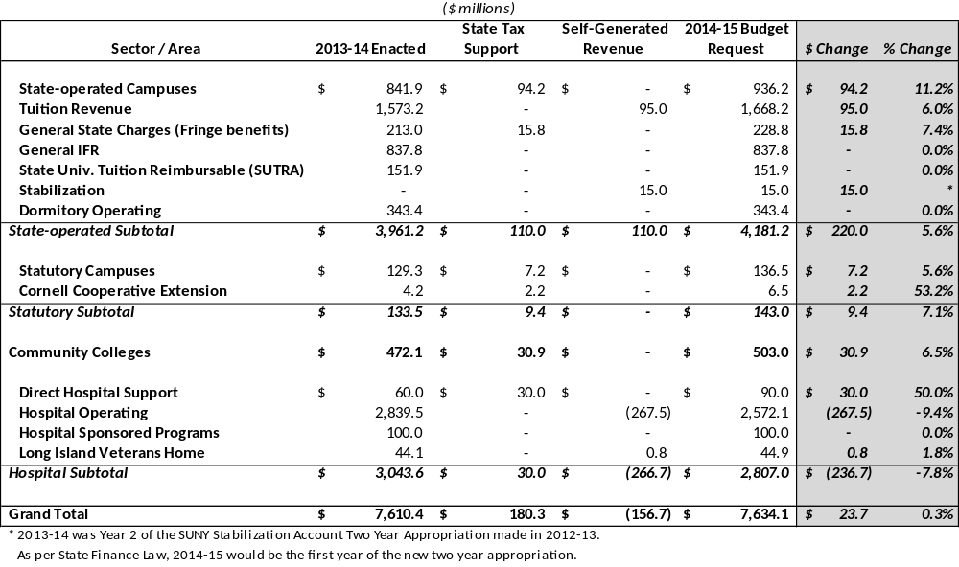
2014-15 Operating Budget Request

Slide 6
State-operated / Statutory Campuses
State-operated Campuses: $220.0M net increase
    $94.2M State tax support for contractual costs / initiatives
    $15.8M State tax support for fringe benefits
    $95.0M Rational Tuition Spending Authority
    $15.0M Stabilization appropriation
  State funding request focuses on costs to continue / key initiatives to improve SUNY operations and support mission
    $98.0M: Contractual salary costs / fringe benefit costs
    $ 6.0M: Open SUNY – Strategic Enrollment Growth Program
    $ 4.0M: SUNY Innovators Program
    $ 2.0M: Expanded U-Wide Flexibility and Support for Initiatives
Statutory Campuses: $9.4M net increase
  Funding request provided by Statutory campuses

Slide 7
Rational Tuition Plan: Year Four of Five
 | Maximum Tuition Rate Inc. |  | % Enrollment |  | % Revenue
 | Resident | Non-Resident | Resident | Non-Resident | Resident | Non-Resident
Undergrad at Centers | $300 | 10.00% | 25.97% | 4.64% | 18.98% | 9.89%
Undergrad at Comp/Tech | $300 | 5.00% | 52.48% | 3.02% | 38.35% | 5.45%
Graduate | $500 | 10.00% | 6.74% | 3.00% | 8.28% | 6.84%
MBA | 9.00% | 10.00% | 0.57% | 0.15% | 0.86% | 0.37%
Masters of Social Work | 9.00% | 10.00% | 0.54% | 0.02% | 0.73% | 0.04%
Masters of Architecture | 9.00% | 10.00% | 0.04% | 0.02% | 0.05% | 0.04%
Physicians Assistant | 9.00% | 20.00% | 0.07% | 0.04% | 0.09% | 0.09%
Law | 9.00% | 10.00% | 0.31% | 0.03% | 0.86% | 0.13%
Pharmacy | 9.00% | 10.00% | 0.23% | 0.03% | 0.64% | 0.15%
Medicine | 9.00% | 5.00% | 1.29% | 0.07% | 5.18% | 0.50%
Dentistry | 9.00% | 10.00% | 0.26% | 0.04% | 0.91% | 0.30%
Optometry | 10.00% | 10.00% | 0.15% | 0.03% | 0.40% | 0.15%
Physical Therapy / Nursing Practice | 9.00% | 10.00% | 0.26% | 0.02% | 0.64% | 0.08%
Enrollment based on FTE

Slide 9
Community Colleges
Total Request: $30.9M net increase
  $ 34.9M: $250 / FTE Base Aid Increase
  $ 7.8M: FIT upper division / grad. chargeback
  $ 3.0M: Increase Job Linkage Program
  $(14.9M): Lower State support need due to enrollment decrease
Funding:
  Focuses on increasing State share of CC costs
  Facilitates implementation of chargeback methodology
  Maximizes community / business relationships

Slide 10
Hospitals
Total Request: $(236.7M) net decrease
  $30.0M in new State tax support
    Returns State tax funding to 2012-13 Enacted levels
  $(267.5M) in reduced spending authority
    Reflects Downstate restructuring and adjusting for historically unspent revenue based appropriation authority
  $0.8M spending authority for Long Island Veterans Home
Items for further discussion:
  Operational structure and flexibility
  Alternative flow of funds to the medical schools

Slide 11
Summary of Capital Plan & Budget Request
2014-15 Capital Plan & Request (in millions)
Program* | 2014/15 Request | 2014/15 Plan Need | 5-Year Request | 5-Year Plan Need | Appropriation Type
Educational Facilities | $750.0 | $2,680.0 | $3,750.0 | $8,560.0 | Bonded
Hospitals | 600.0 | 600.0 | 1,205.0 | 1,205.0 | Bonded, Debt Repaid
Residence Halls | 50.0 | 50.0 | 250.0 | 250.0 | Hard Dollar, Self Pay
Community Colleges | 91.0 | 134.0 | 575.0 | 575.0 | Bonded, 50% State Share
SUNY-Wide Capital Initiatives:
Transformational Information Technology Initiative | 189.0 | 189.0 | 189.0 | 189.0 | Bonded
Research Initiative | 200.0 | 200.0 | 200.0 | 1,587.0 | Bonded, Competitive Based
Energy Initiative | 100.0 | 100.0 | 100.0 | 100.0 | 50% Bonded, 50% Dry
Total | $1,980.0 | $3,953.0 | $6,269.0 | $12,466.0
*Request includes reappropriations totaling $4.7B in support of all four programs and an appropriation to support campus-funded capital projects of $100M.

Slide 12
Educational Facilities
SUNY 5-year Capital Plan project needs have been scaled back from $8.56B to $3.75B, funding only critical maintenance components.
  Excludes funding for new facilities.
Annual bonded investment of $750M in bond-financed State support will:
  Maintain progress made in reducing SUNY’s critical maintenance backlog since 2007
  Advance major portions of the present Capital Plan.
Requested funding will:
  Fund critical life safety projects,
  Ensure that buildings
  are in compliance with current building
  codes, and
  Stabilize / modernize deteriorating infrastructure.

Slide 13
Hospitals
$600M in (repaid) bonded funding requested.
SUNY hospitals have not received bonded funding since 2008, with UMC and SB largely exhausting available funding.
Lack of new funding endangers maintaining safe and modern facilities, ensuring patient safety, and meeting accreditation requirements.
This level of funding is essential as full project funding is required by State regulatory process governing construction, renovation and major medical equipment acquisitions of health care facilities.
Although appropriations must be in place to facilitate capital planning, actual spending from the appropriations occur at a slower pace.
To better align capital funding with the health care planning process, ensure continuous access to capital, and remove hospital debt from the State debt cap calculation, it is recommended that an alternative financing structure be explored.

Slide 14
Residence Halls
$250M ($50M/Year for 5-Years and consistent with current State Financial Plan) is requested in hard dollar (pay-as-you-go) support to support small maintenance and repair projects.
The residence hall bonding program was restructured in 2013/14 such that future debt issuances are eliminated from the State debt cap calculations as well as the need for future capital bonded appropriation. Although the restructuring of the program provided significant relief to the State under the constraints imposed by the debt caps, that benefit did not accrue to SUNY’s remaining bond-financed capital programs.
A bond limit of $944M was established for the bond-financed portion of the program for the next five years, which is sufficient to meet the $744M in demand reflected in the most recent campus capital plans.
The September 2013 bond sale ($440M) issued $175M in bonds to progress more than 100 projects over the next 12-15 months and refunded prior resolution bonds and instantly generated an additional $265M in debt cap capacity for the entire State.
In 2014/15 additional bonds of $175M are expected to be issued to finance new and existing capital projects.

Slide 15
Community Colleges
$91M request reflects State share of community college projects which have local sponsor resolutions in place.
$134M in projects have been initially planned by the Colleges for 2014/15.
$45M worth of projects have not received local sponsor support to-date and will be shifted to subsequent years,
This leaves the requested amount of $91M.
The requested amount will support:
  37 critical maintenance and health and safety projects.
  29 renovation with critical maintenance components projects and 3 new facilities.

Slide 16
Other SUNY-Wide Capital Initiatives
Transformational Information Technology Initiative: A total of $189M is requested to support the infrastructure necessary to support several System-wide academic, research and operational initiatives.
Open SUNY
  Student Access, Completion and Success ($93M): SUNY Recruitment and Application Processing System, SUNY-wide student identity tracking and management, seamless student information system, degree planning system, course equivalency system, academic data integration system, data warehousing and decision support system, Open SUNY Student Access Platform, student internship and experiential learning management system, student ePortfolio system, next generation SUNY classrooms, open digital library and content system.
Operational Efficiency
SUNY Electronic Procurement Platform ($10M): Establish an electronic procurement system, transaction processing center, and strategic sourcing, potentially producing annual savings of $100M.
SUNY Shared Data Centers and Telecom ($33M): Shared regional data centers, network operation center, and security operation center, reducing number of data centers from hundreds to six. Creating SUNY-wide, cloud-based unified communication and reducing telecom costs by 25%.
SUNY Self-Service Platform ($4M): Self-service functions for HR, financial, and other operational transactions, reducing administrative expenses.
Research, Innovation and Economic Development
SUNY Collaboration Platform ($22M): SUNY-wide Intranet SUNY Blue, portal for networks for excellence, and telepresence video conference network. Will reduce communication and travel costs and enable widespread collaboration for research and innovation.
SUNY Knowledge Center ($27M): Housed at University of Albany, shared by 64 campuses, this Center includes high performance computing facilities and smart data transport and storage optimized to support large scale data analysis and decision support, shared by SUNY-wide communities of researchers for algorithm design and data visualization, stimulating and supporting SUNY’s research growth of over $500M in the next 10 years.

Slide 17
Other SUNY-Wide Capital Initiatives (Continued)
SUNY Research Initiatives: A total of $200M is requested to provide seed funding for a new competitive program to select projects that will enable SUNY to further advance its goal of doubling the amount of sponsored research System-wide over the next five years.
Energy Initiative: A total of $100M is requested (50% State-funded / 50% “dry”) to support energy efficiency projects and enable campuses to significantly reduce their energy usage. The dry portion of this program could be supported by grants or loans from entities such as the New York Power Authority.

Slide 19
Resident Undergraduate Tuition Rates
2010/11 - Projected 2015/16
Rational Tuition Period

Slide 20
Non-Resident Tuition Rates at the Four SUNY University Research Centers
2010/11 – Projected 2015/16
Rational Tuition Period

Slide 21
SUNY Enrollment Weighted Average In-State Tuition and Fees
Proposed 2014-15 SUNY vs. 2013-14 NY Private Schools

